Slide 1
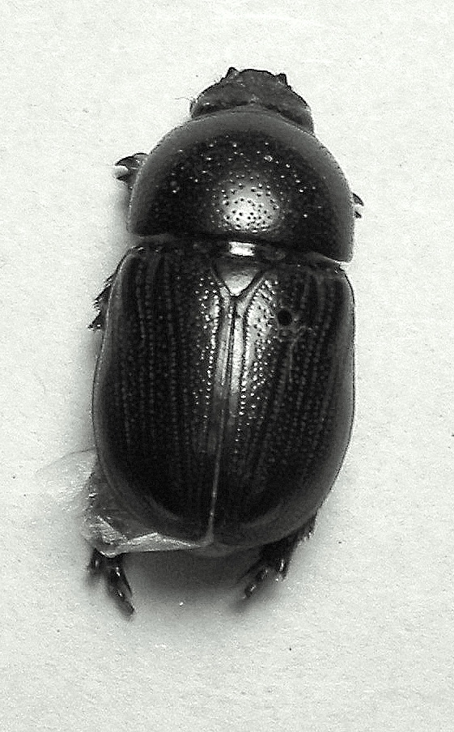

Beetle-FX
w Zabierzowie chrząszcz brzmi w trzcinie
(In the town of Zabierzów a beetle buzzes in the reeds)

Slide 2
What is Beetle-FX?
Beetle-FX is a tool that allows businesses to 1) identify their own financial flows in terms of region and currency, 2) clearly understand where they could gain a financial edge in international trade and 3) take instant action through HSBC systems
For HSBC to automatically detect and engage additional sources of income in international trade
Beetle-FX is 1 step towards mass-personalisation of financial services - i.e. better customer satisfaction

Slide 3
Who it is for?
Any organisation that operates in several regions and/or currencies
Internet based companies who have a overseas sales
Larger companies who operate cross-borders
Small shops who rely on tourist trade
Who accept credit / debit card payments
Who have many foreign tourist customers
who wish to price and transact multi currency pricing in store (akin to Ferry companies) without the hassle of rapidly changing exchange rates.

Slide 4
What does it do?
Shows source and volume breakdown of customer transactions by area
Calculates optimised accounts setup to reduce transfer fees
Calculates optimised exchange rate
Allows HSBC to offer propositions based upon total income by currency

Slide 5
What can we Propose?
Check to see if current receipts are optimised
Offer the scheme to optimise their foreign transactions (exchange rates & transfer fees)
Offer access to HSBC international trading services, loans and credit
Directly open the account in the foreign currency ready for trading

Slide 6
How does it do it?
Used the transaction history to identify the location of transactions
Totals up overall income by region & currency
Uses FX API to work out currency exchange to offer ‘best’ value for money for exchange back to customers currency
Utilises the Account Opening API to open foreign currency account
And of course the Google Maps API

Slide 7
Thank You
Pierre DE LEUSSE
Piotr MASLANKA
Przemyslaw J CZAJKOWSKI
Radoslaw M KAPLONIAK
Richard J COLLEY

